Slide 1


Recurrent Neural Network using TensorFlow
Youngjae Yu (yj.yu@vision.snu.ac.kr)
Byeongchang Kim (byeongchang.kim@vision.snu.ac.kr)
Notes:
실습 시작하도록 하겠습니다.
안녕하세요. 저는 컴퓨터공학부 시각 및 학습 연구실에서 박사과정 중인 노준혁이라고 합니다.
이번 시간에는 텐서플로우를 이용하여 이미지를 어떻게 처리하는지, 최종적으로는 CNN 모델까지 만들어보는 시간을 갖도록 하겠습니다.

Slide 2
Contents
RNN Basics
Tensorflow Basics
Tensorflow APIs for RNN
Practice – RNN
Practice – Monitoring
Advanced

Slide 3
RNN Basics

Slide 4
Recurrent Neural Networks!
RNNs tie the weights at each time
Condition the neural network on all previous words
RAM requirement only scales with number of words
(Slide credit: cs224d)

Slide 5
RNN Basics
(Image credit: Karpathy’s blog)

Slide 6
RNN Basics
(Image credit: Karpathy’s blog)

Slide 7
RNN Basics
(Image credit: Karpathy’s blog)

Slide 8
RNN Basics
(Image credit: Karpathy’s blog)

Slide 9
RNN Basics
(Image credit: Karpathy’s blog)

Slide 10
RNN Basics

Slide 11
RNN Basics

Slide 12
RNN Basics

Slide 13
RNN Basics

Slide 14
RNN Basics
(Image credit: WildML)

Slide 15
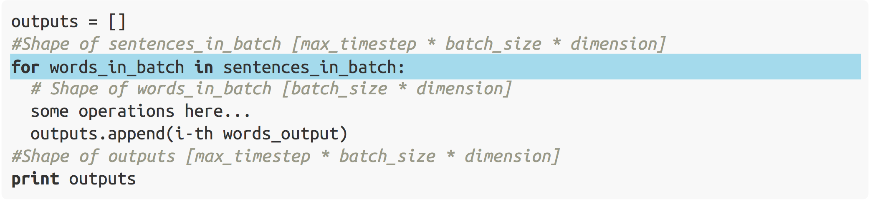
Time step and Batch
Time steps are defined by sequences length
The batch size is defined by user
Time major representation
[max_timestep * batch_size * dimension]
Originally, [batch_size * max_timestep * dimension]
RNNs typically use time major representation

Slide 16
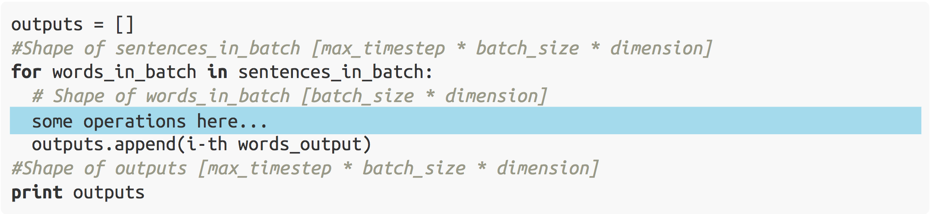
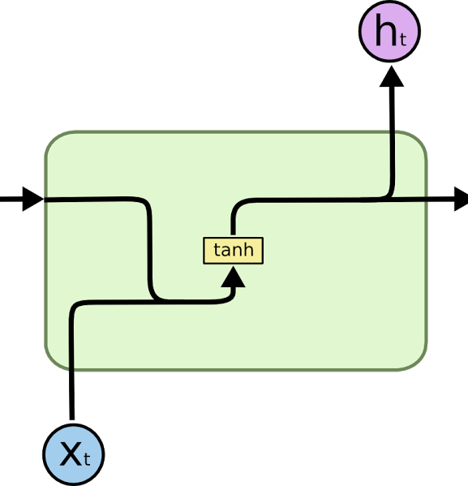
RNN Cells (Memory Units)
RNN
(Image credit: Colah’s blog)

Slide 17
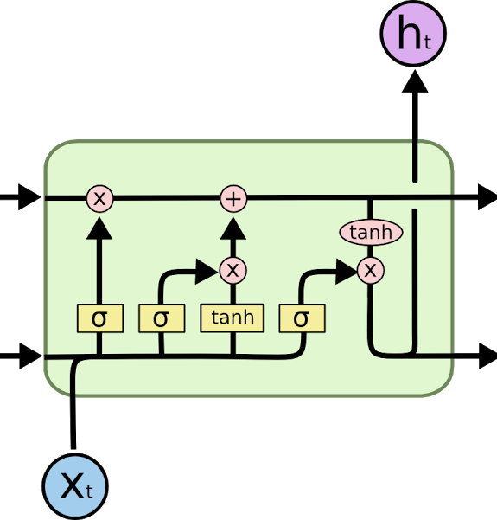
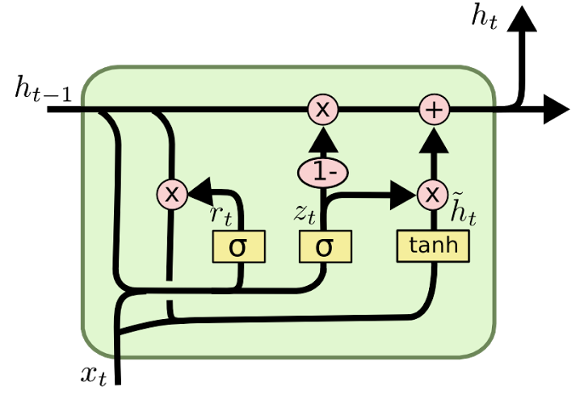
RNN Cells (Memory Units)
LSTM
GRU
(Image credit: Colah’s blog)

Slide 18
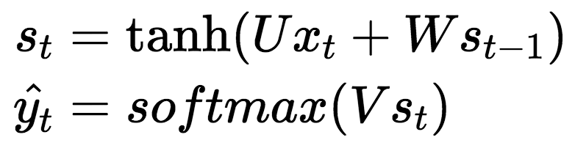
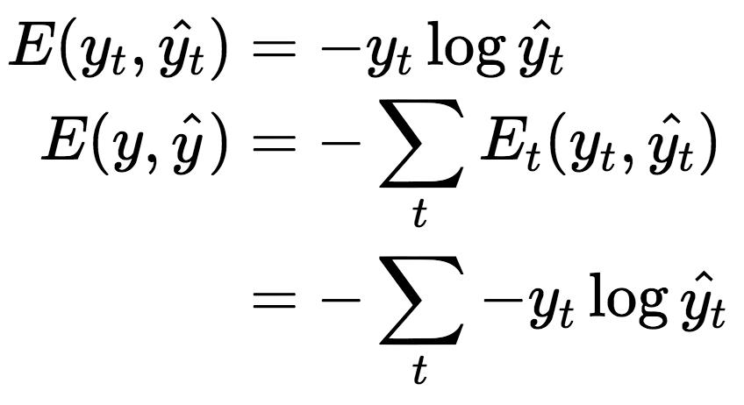
RNN Loss and Optimization
Simple RNN
Cross Entropy Loss

Slide 19
RNN Loss and Optimization
BackProp

Slide 20
Tensorflow Basics

Slide 21
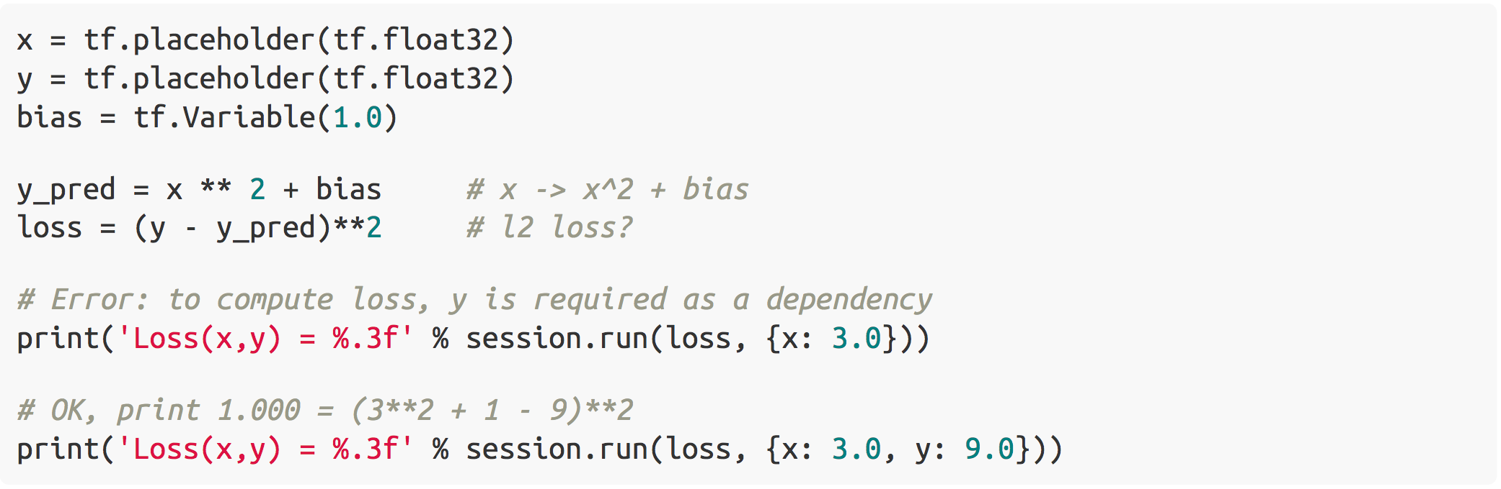
Tensorflow Basics
(1) Fetch tensors via Session.run()

Slide 22
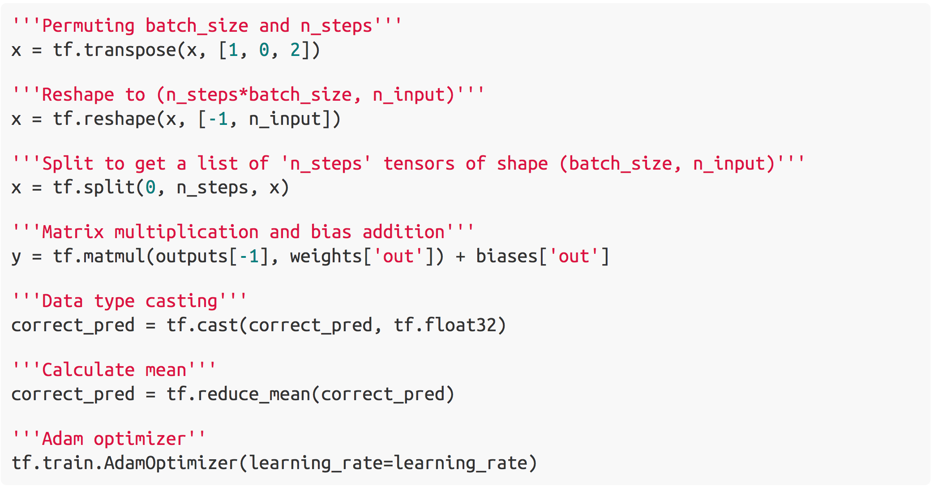
Tensorflow Basics
(2) Basic operations

Slide 23
Tensorflow Basics
(3) Build, Train, Test

Slide 24
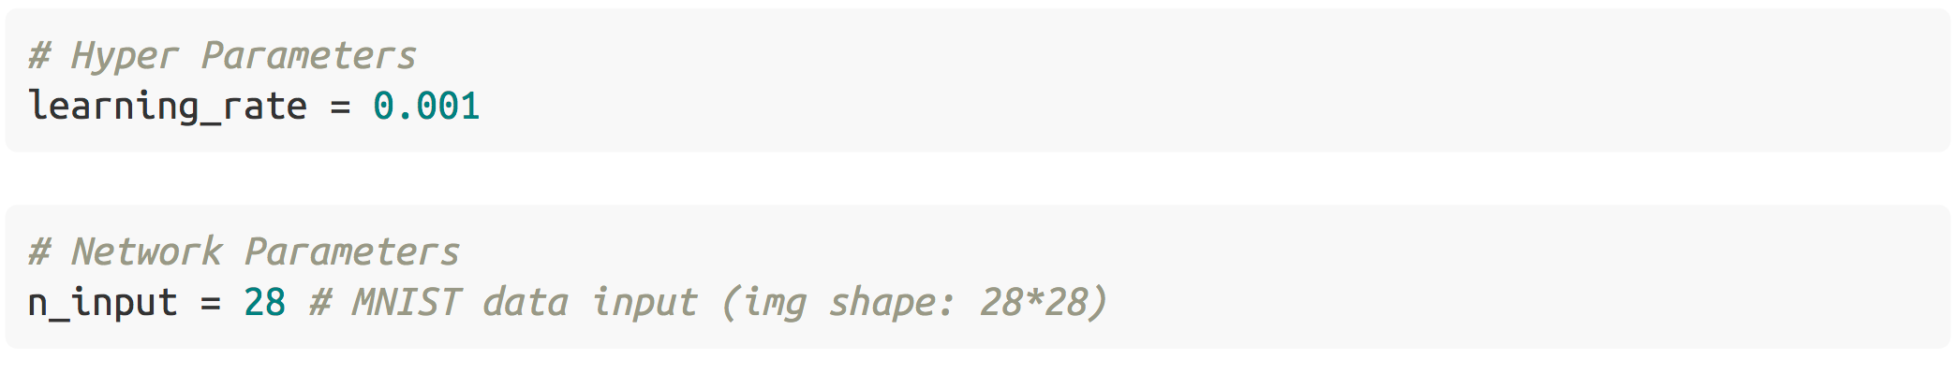
Tensorflow Basics
(3) Build, Train, Test

Slide 25
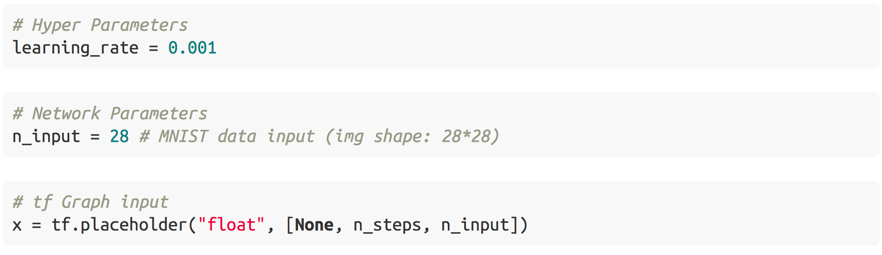
Tensorflow Basics
(3) Build, Train, Test

Slide 26
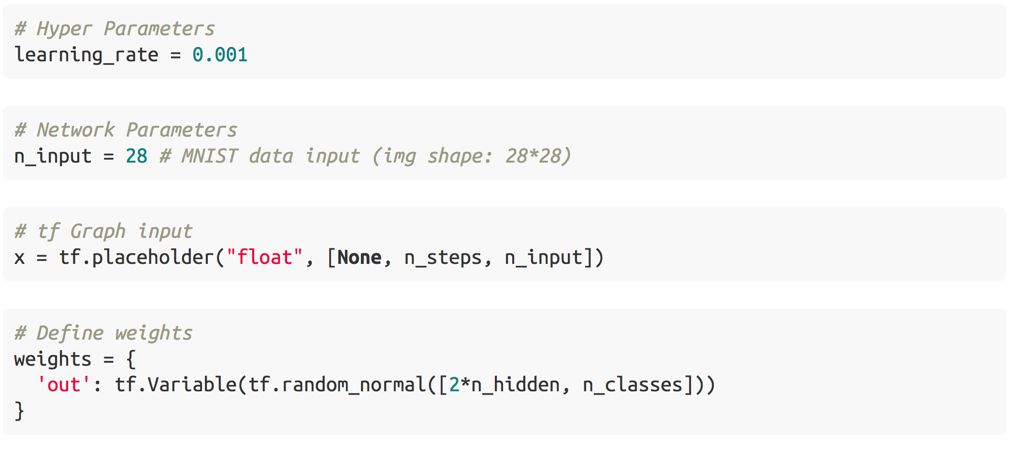
Tensorflow Basics
(3) Build, Train, Test

Slide 27
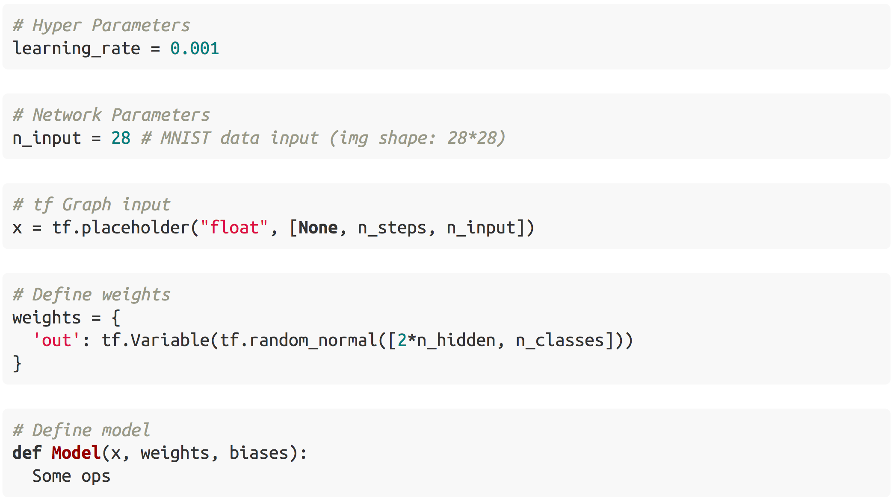
Tensorflow Basics
(3) Build, Train, Test

Slide 28
Tensorflow Basics
(3) Build, Train, Test

Slide 29
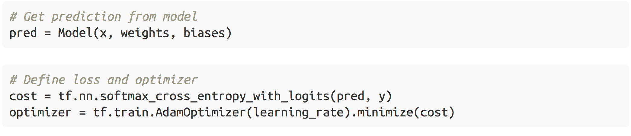
Tensorflow Basics
(3) Build, Train, Test

Slide 30
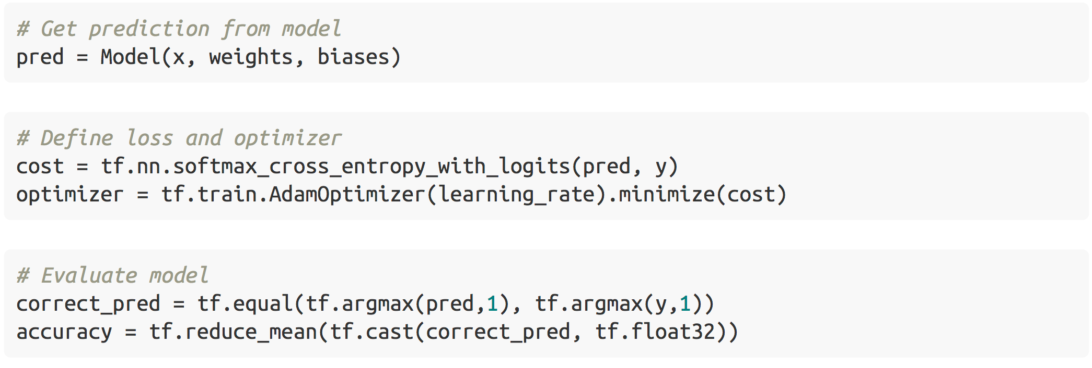
Tensorflow Basics
(3) Build, Train, Test

Slide 31
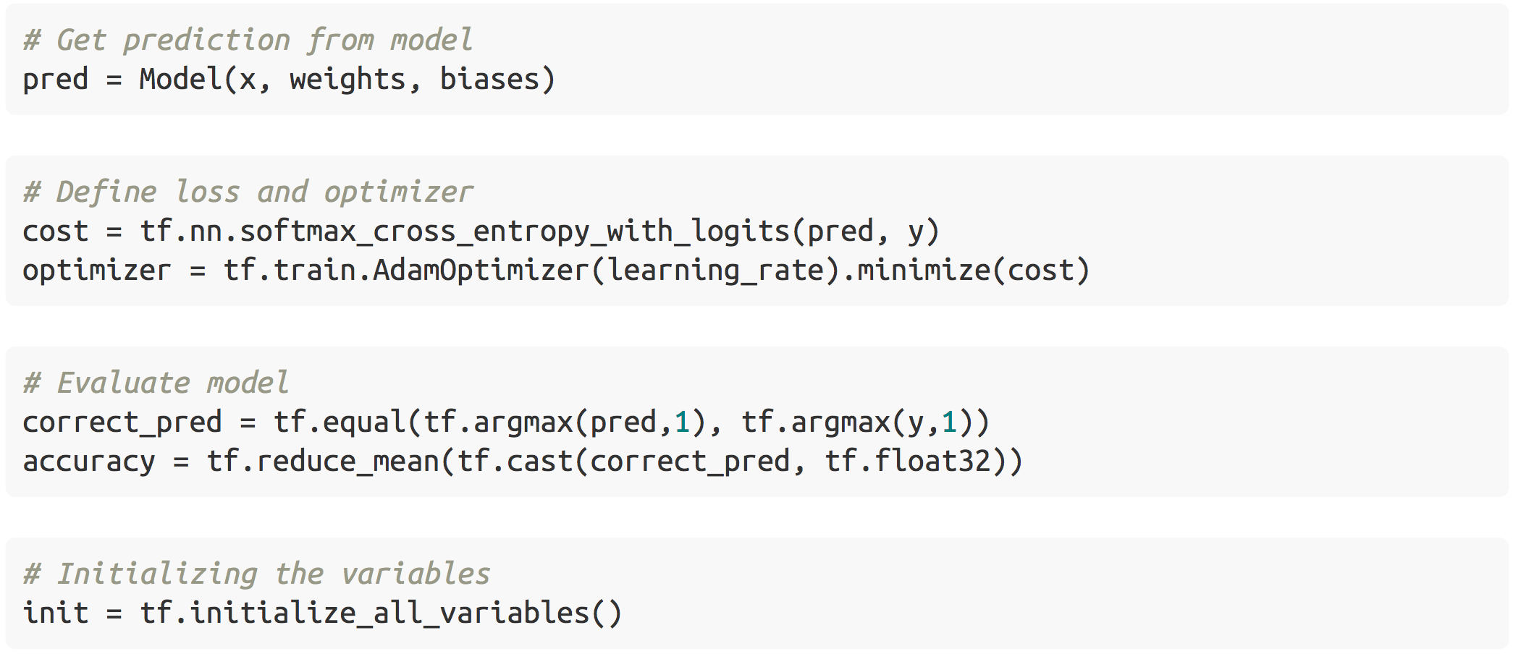
Tensorflow Basics
(3) Build, Train, Test

Slide 32
Tensorflow Basics
(4) Document
https://www.tensorflow.org/api_docs/
https://www.tensorflow.org/tutorials/
https://www.tensorflow.org/tutorials/recurrent/

Slide 33
Tensorflow APIs for RNN

Slide 34
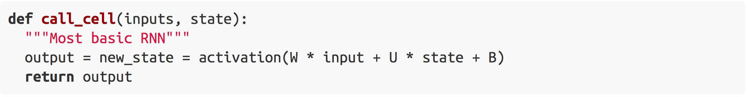
RNN Cells
Pre-defined class how to calculate the output
tf.nn.rnn_cell.RNNCell()
tf.nn.rnn_cell.LSTMCell()
tf.nn.rnn_cell.GRUCell()

Slide 35
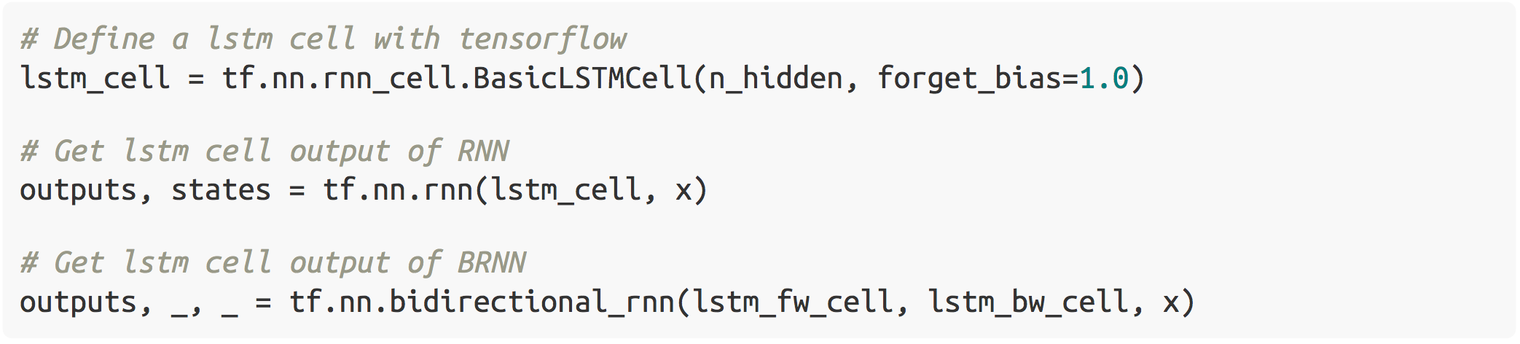
Where do I have to call call_cell()
Using RNN wrapper

Slide 36
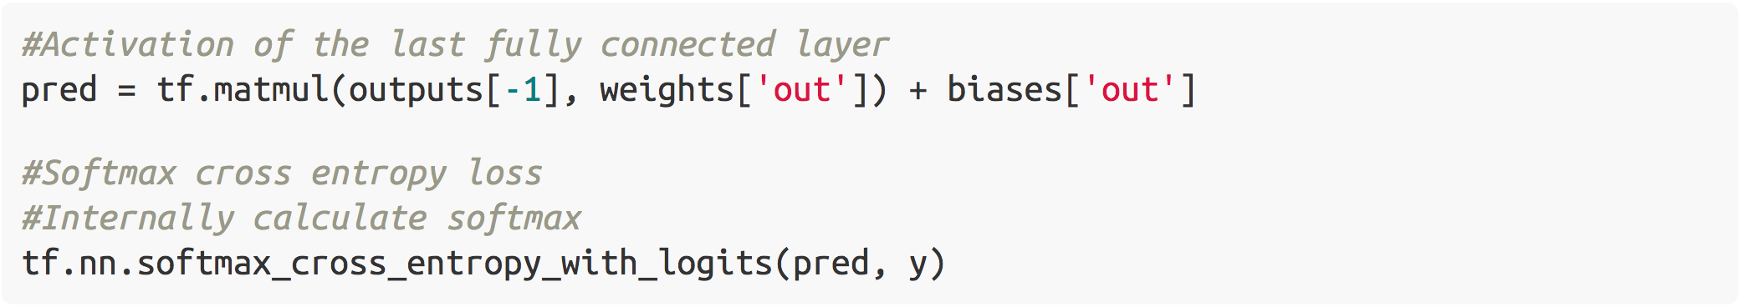
RNN Loss

Slide 37
Practice – RNN
1_practice_rnn.ipynb

Slide 38
MNIST Dataset
Hand written digits
10 classes
28 x 28 size images
Labels are one-hot encoded

Slide 39
MNIST Dataset
Each image has 28 x 28 = 784 pixels
Consists of two parts
Train: 55,000 images
Test: 10,000 images
http://yann.lecun.com/exdb/mnist/
train-images-idx3-ubyte.gz
train-labels-idx1-ubyte.gz
test-images-idx3-ubyte.gz
test-labels-idx3-ubyte.gz

Slide 40
Practice – Monitoring
2_practice_monitoring.ipynb

Slide 41
Visualizing Log Data with TensorBoard

Slide 42
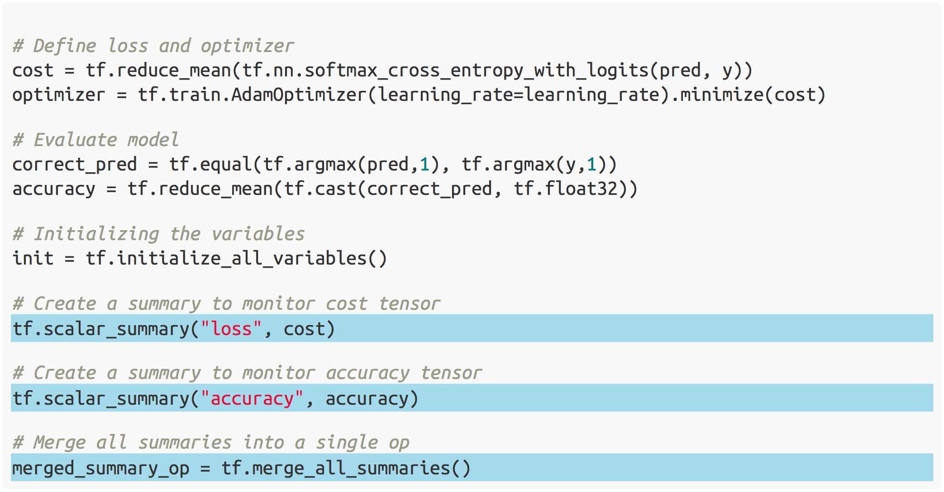
Visualizing Log Data with TensorBoard

Slide 43
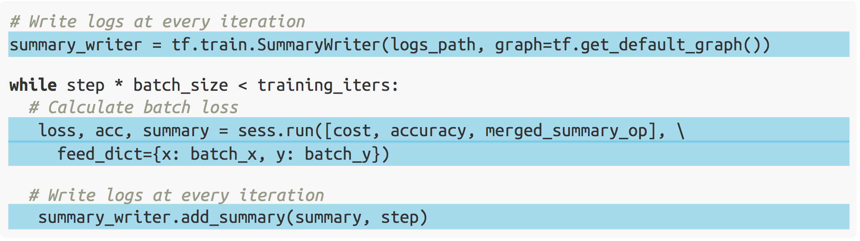
Visualizing Log Data with TensorBoard

Slide 44
Advanced

Slide 45
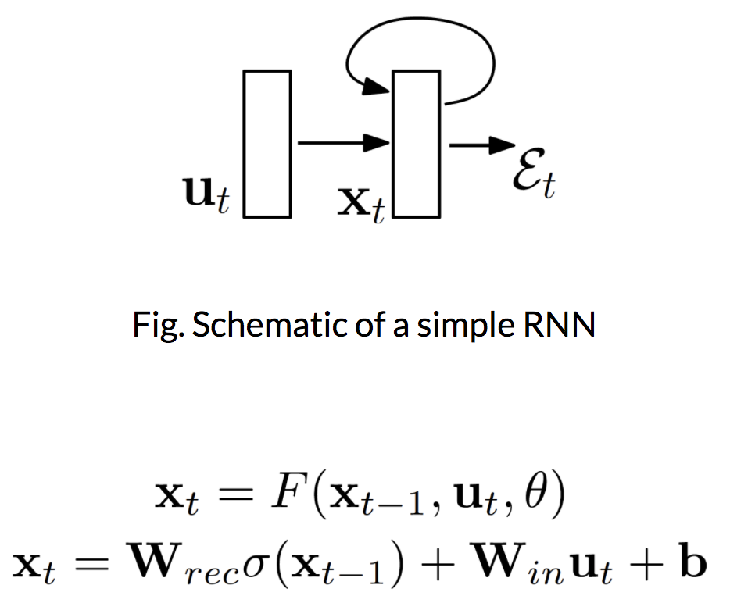
Difficulty of training RNNs

Slide 46
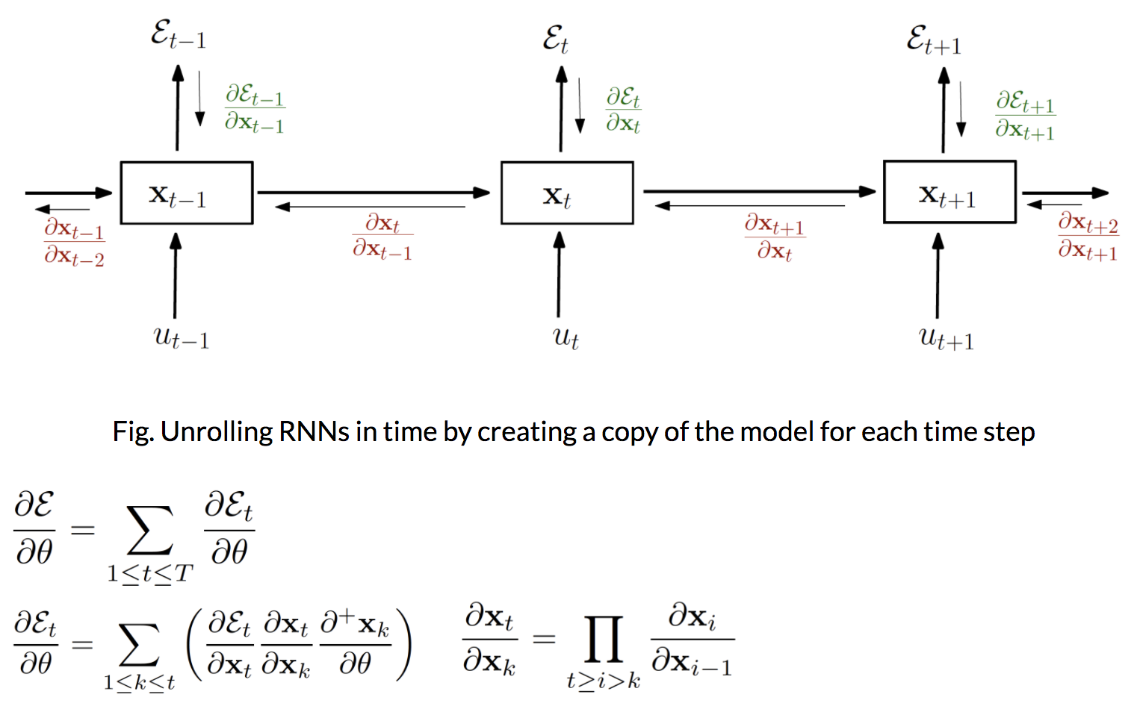
Difficulty of training RNNs

Slide 47
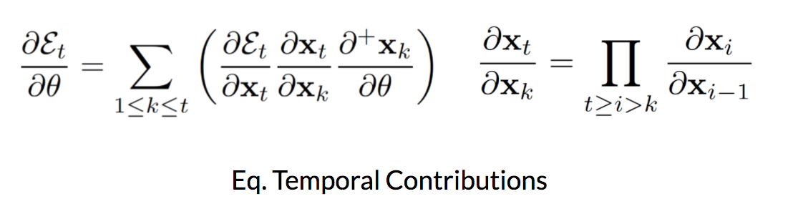
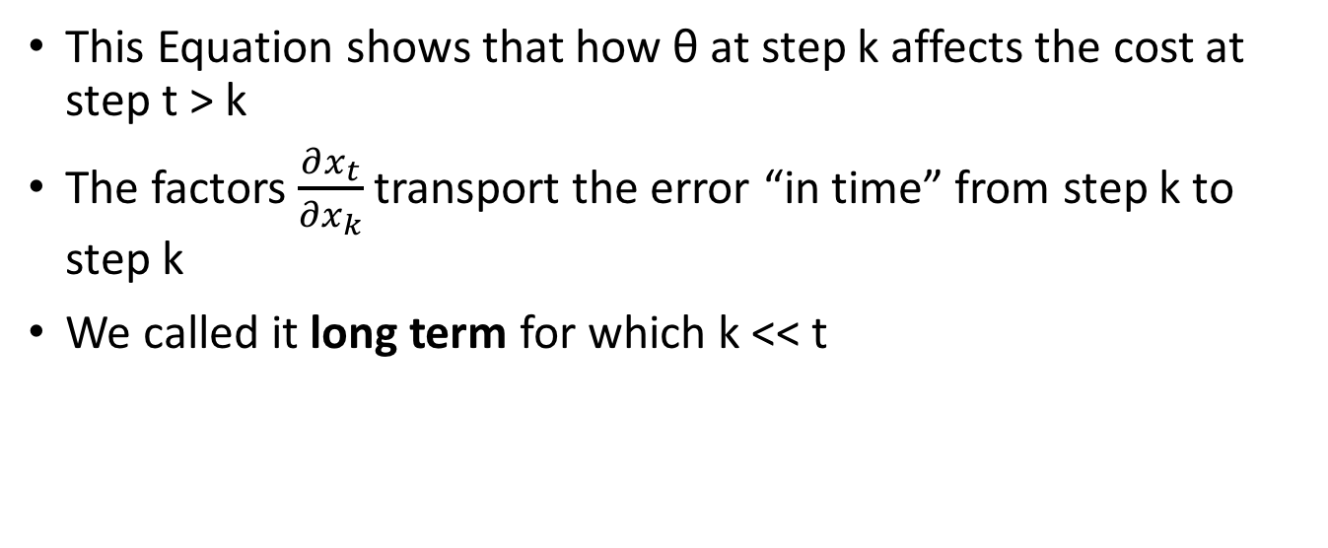
Difficulty of training RNNs
This Equation shows that how θ at step k affects the cost at step t > k
The factors $\frac{∂x_{t}}{∂x_{k}}$ transport the error “in time” from step k to step k
We called it long term for which k << t

Slide 48
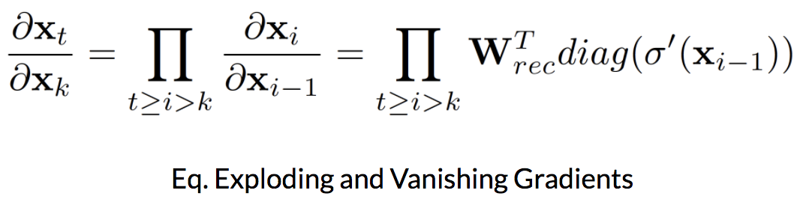
Difficulty of training RNNs
For long term this equations show that gradients can be exploding or vanishing
(Image credit: DeepLearningBook)

Slide 49
Difficulty of training RNNs
Solutions
Using L1 or L2 penalty on the recurrent weights
It can help exploding gradients, but not for vanishing
This approach limits the model to a simple regime, where any information inserted in the model has to die out exponentially fast in time
Teacher forcing
This can help the model go to the right region of space
It can reduce the chance that gradients exploding
This approach requires a target to be defines at every time
Memory unit (e.g. LSTM or GRU)
This can help vanishing gradients
This approach does not address explicitly the exploding gradients problem

Slide 50
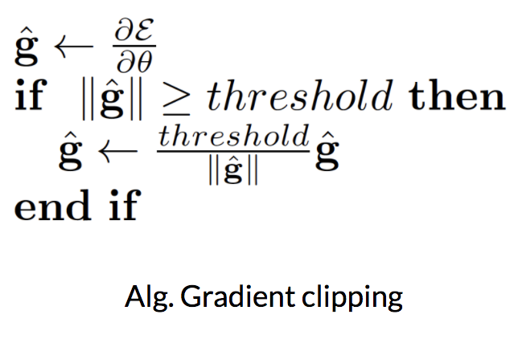
Difficulty of training RNNs
Solutions
Simple mechanism to deal with a sudden increase in the norm of the gradients is to rescale them whenever they go over a threshold
In experiments, training is not very sensitive to this hyperparameter and the algorithm behaves well even for rather small thresholds

Slide 51
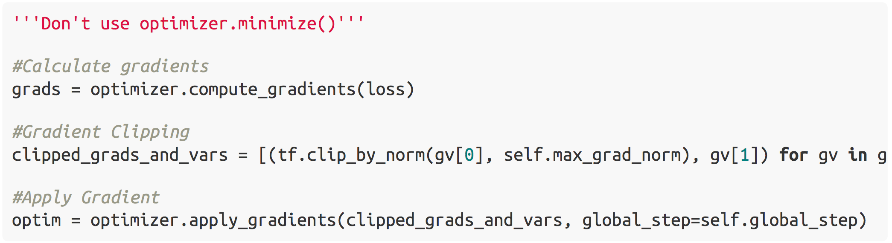
Gradient Clipping

Slide 52
RNN vs. Dynamic RNN
tf.nn.rnn creates an unrolled graph for a fixed RNN length
e.g. creating static graph with 200 RNN steps
1) graph creation is slow
2) unable to pass longer sequences (>200) than originally specified
tf.nn.dynamic_rnn solves this!
Internally use tf.While to dynamically construct the graph
1) faster creation
2) can feed batches of variable size
In short, just use tf.nn.dynamic_rnn.

Slide 53
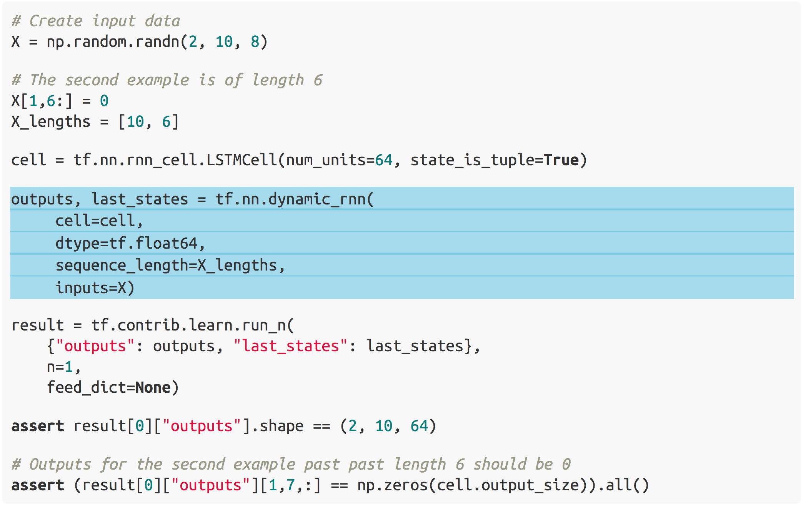
Dynamic RNN

Slide 54
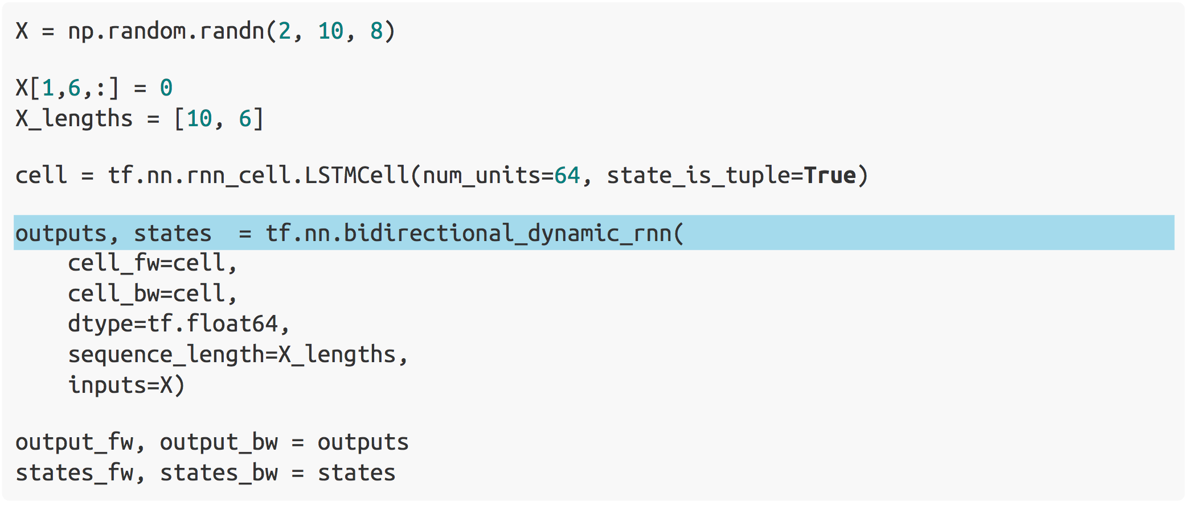
Bidirectional Dynamic RNN

Slide 55
References
Tensorflow official webpage
http://www.tensorflow.org/
Stanford CS class – CS224d
http://cs224d.stanford.edu
Colah’s blog
http://colah.github.io
Karpathy’s blog
http://karpathy.github.io
Tensorflow Examples
https://github.com/aymericdamien/TensorFlow-Examples
WildML
http://www.wildml.com

Slide 56
Thank you!

